Slide 1




Slide 2

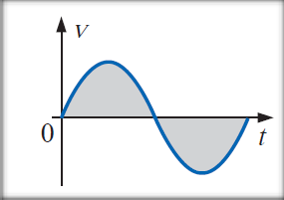

Slide 3











































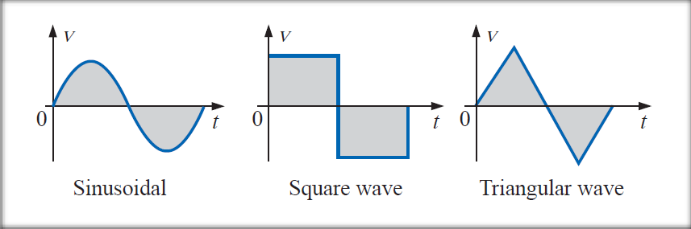















Although elaboration of ac is alternating current, the terms ac voltage and ac current is used for sinusoidal voltage and sinusoidal current without any confusion. Other alternating waveform patterns have descriptive term with them such as square wave, triangular wave, saw-tooth wave etc.
Figure: Alternating Waveforms
Sources of ac power can be ac generator, wind power station, hydroelectricity, solar panel, function generator etc.
Reference: Circuit Analysis by Robert Boylestad, Topic – 13.1, 13.2, Page – 522, 523

Slide 4
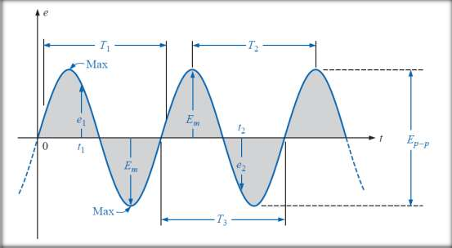


























































Figure: Sinusoidal
Voltage
Waveform: The path traced by a quantity, such as the voltage in Figure plotted as a function of some variable such as time, position, degrees, radians, temperature and so on.
Instantaneous value: The magnitude of a waveform at any
instant of time; denoted by lowercase letters (e1, e2).
Reference: Circuit Analysis by Robert Boylestad, Topic – 13.2, Page – 523

Slide 5










































Figure: Sinusoidal
Voltage
Peak amplitude: The maximum value of a waveform as measured from its average, or mean, value, denoted by uppercase letters (such as E_{m} for sources of voltage and V_{m} for the voltage drop across a load). For the waveform of Figure, the average value is zero volts, and E_{m} is as defined by the figure.
Reference: Circuit Analysis by Robert Boylestad, Topic – 13.2, Page – 523

Slide 6



















Figure: Sinusoidal
Voltage
Peak value: The maximum instantaneous value of a function as measured from the zero-volt level. For the waveform of figure, the peak amplitude and peak value are the same, since the average value of the function is zero volts..
Reference: Circuit Analysis by Robert Boylestad, Topic – 13.2, Page – 523

Slide 7



















































Figure: Sinusoidal
Voltage
Peak-to-peak value: Denoted by E_{p-p} or V_{p-p}, the full voltage between positive and negative peaks of the waveform, that is, the sum of the magnitude of the positive and negative peaks.
Periodic waveform: A waveform that continually repeats itself after the same time interval. The waveform of figure is a periodic waveform.
Reference: Circuit Analysis by Robert Boylestad, Topic – 13.2, Page – 523

Slide 8

































Figure: Sinusoidal
Voltage
Period (T ): The time interval between successive repetitions of a periodic waveform (the period T₁ = T₂ = T₃ in figure), as long as successive similar points of the periodic waveform are used in determining T.
Reference: Circuit Analysis by Robert Boylestad, Topic – 13.2, Page – 523

Slide 9






















Figure: Sinusoidal
Voltage
Cycle: The portion of a waveform contained in one period of time. The cycles within T₁, T₂, and T₃ different in figure, but they are all bounded by one period of time and therefore
satisfy the definition of a cycle.
Reference: Circuit Analysis by Robert Boylestad, Topic – 13.2, Page – 523

Slide 10
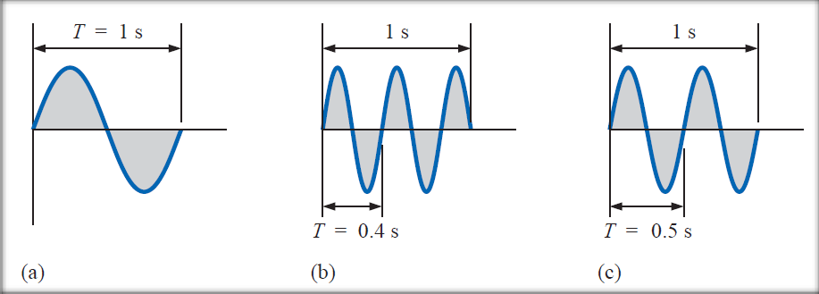


































Frequency ( f ): The number of cycles that occur in 1s. The frequency of the waveform of fig – (a) is 1 cycle per second, for fig – (b) is 2.5 cycles per second.
The unit of measure for frequency is the hertz (Hz), and
1Hz = 1 cycle per second
From definition we get,
Reference: Circuit Analysis by Robert Boylestad, Topic – 13.2, Page – 523

Slide 11











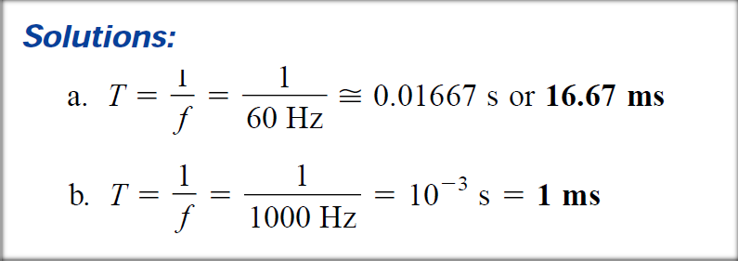
Math. Problem: Find the period of a periodic waveform with a frequency of
a. 60 Hz.
b. 1000 Hz.

Slide 12
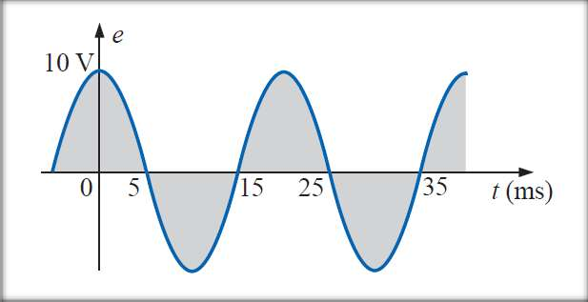

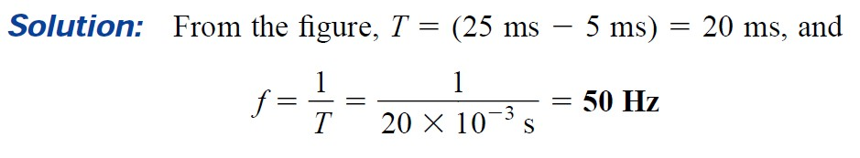
Math. Problem: Determine the frequency of the waveform as shown in figure.

Slide 13






















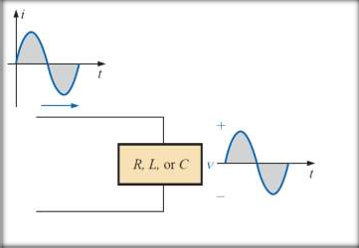





















Sinusoidal Wave: The sinusoidal waveform is alternating waveform whose shape is unaffected
the only
by the
response characteristics of R, L, and C elements. Phase of the
output wave may change.
General expression to represent a sinusoidal wave:
v = V_{m} sin(ωt+θ) = V_{m} sin(2πft+θ)
Reference: Circuit Analysis by Robert Boylestad, Topic– 13.5, Page – 535

Slide 14





































Math. Problem: Determine (a) peak value (b) peak to peak value (c) period (d) frequency (e) phase for the following sinusoidal waves:
i. v = 60 sin(1800t+20°)
ii. v = 60 sin(2π1000t-60°)
Reference: -

Slide 15




























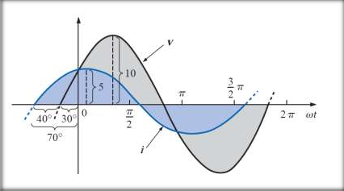

















the sinusoidal
What is the phase relationship between waveforms of each of the following sets?
a. v = 10 sin(ωt + 30°) and i = 5 sin(ωt + 70°)
b. i = 15 sin(ωt + 60°) and v = 10 sin(ωt – 20°)
i = 2 cos(ωt + 10°) and v = 3 sin(ωt – 10°)
i = – sin(ωt + 30°) and v = 2 sin(ωt + 10°)
e. i = – 2 cos(ωt – 60°) and v = 3 sin(ωt – 150°)
Solution:
a. From the figure –
i leads v by 40° or v lags i by 40°
Reference: Circuit Analysis by Robert Boylestad, Example – 13.12, Page – 537

Slide 16

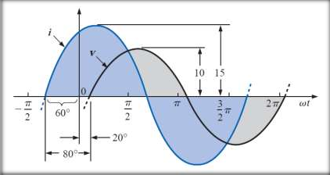

























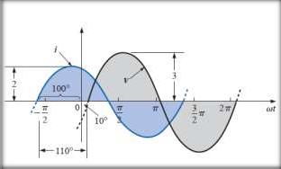






b. i = 15 sin(ωt + 60°) and v = 10 sin(ωt – 20°)
Solution:
From the figure –
i leads v by 80° or v lags i by 80°
c. i = 2 cos(ωt + 10°) and v = 3 sin(ωt – 10°)
Solution:
i = 2cos(ωt+10°) = 2sin(ωt + 100°) From the figure –
i leads v by 110° or v lags I by 110°
Reference: Circuit Analysis by Robert Boylestad, Example – 13.12, Page – 537

Slide 17
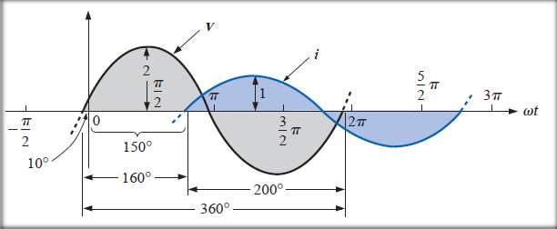









d. i = – sin(ωt + 30°) and v = 2 sin(ωt + 10°)
Solution:
i = – sin(ωt + 30°) = sin(ωt – 150°) = sin(ωt + 210°) v leads i by 160°, or i lags v by 160°.
or, i leads v by 200°, or v lags i by 200°.
Reference: Circuit Analysis by Robert Boylestad, Example – 13.12, Page – 537

Slide 18
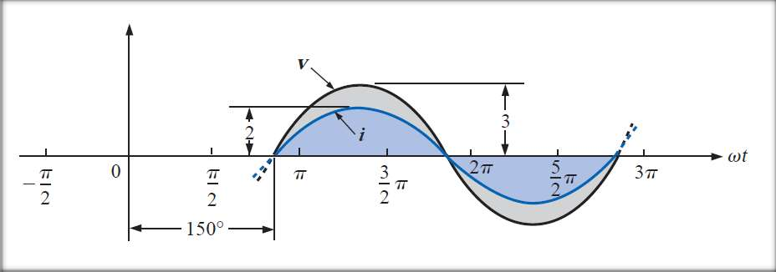




e. i = – 2 cos(ωt – 60°) and v = 3 sin(ωt – 150°)
e. v and i are in phase
Reference: Circuit Analysis by Robert Boylestad, Example – 13.12, Page – 537

Slide 19


